Slide 1
Predictive Modeling using R and Python
William Chiu
JULY 27, 2017

Slide 2
About Me
Manage a team of statisticians and computer scientists for the Dodd-Frank Stress Tests at a regional bank
The team forecasts expected credit loss for each individual residential mortgage and home equity line of credit
Defended methodology, forecasts, and documentation to senior executives, model validators, and bank examiners

Slide 3
Outline
Defining predictive modeling
Statistics versus machine learning
Jobs available by programming languages
Model development process
Predicting survival on the Titanic using R
Predicting median home prices using Python
Concluding remarks

Slide 4
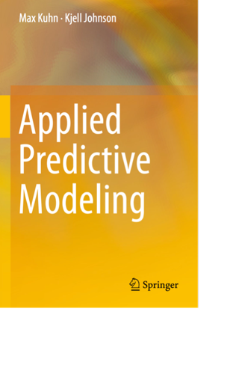
Definition of Predictive Modeling
Predictive modeling: the process of developing a mathematical tool or model that generates an accurate prediction
– Max Kuhn
For the purposes of this document, the term model refers to a quantitative method, system, or approach that applies statistical, economic, financial, or mathematical theories, techniques, and assumptions to process input data into quantitative estimates
- Federal Reserve Board, SR 11-7

Slide 5
Algorithms from Statistics and Machine Learning
Statistics
Machine Learning
Linear regression
Logistic regression
Discriminant Analysis
Random Forest
Gradient Boosting Machine
Classification and Regression Trees
Deep Learning
Lasso
Survival Analysis
K-nearest neighbors
Support Vector Machines
Principal Component Regression
Multivariate Adaptive Regression Splines
Naïve Bayes

Slide 6
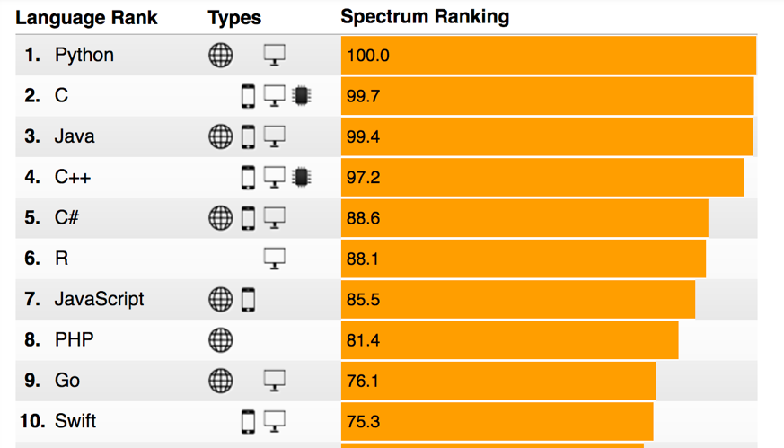
Most popular programming languages
http://spectrum.ieee.org/static/interactive-the-top-programming-languages-2017

Slide 7
Statistics Jobs by Language

Slide 8
Machine Learning Jobs by Language

Slide 9
R
Software | Type | Description
R | Interpreter | Programming engine
RStudio | Integrated Development Environment (IDE) | Advanced text editor
caret | R Package | Model development process tools
xgboost | R Package | Extreme gradient boosting algorithm
dplyr | R Package | Data extraction, exploration, and transformation

Slide 10
Python
Software | Type | Description
Anaconda | Environment Manager and Interpreter | A popular distribution of the Python interpreter with scientific packages
PyCharm | Integrated Development Environment (IDE) | Advanced text editor
Jupyter | Notebook | Local server for Python notebooks
scikit-learn | Python Package | Machine learning algorithms
statsmodels | Python Package | Statistical methods and tests
pandas | Python Package | Data extraction, exploration, and transformation

Slide 11
How to develop a predictive model
Decide what you want to predict (target variable)
Find, extract, and explore the data (e.g., line charts, bar charts, histograms, box-whiskers plots, examine data quality reports)
Transform the data (e.g., calculate the target variable, engineer new features, fill in missing values or remove observations with missing values)
Split the data between train and test (if the data set is too small, use cross-validation methods)
Choose a metric for model performance (e.g., minimum RMSE, maximum AUC)
Try many algorithms – linear regression, lasso, MARS, GAM, Random Forest, Gradient Boosting Trees – on the train data set
Pick the algorithm with the best model performance on the test data set
Estimate the final model using all the data (train and test) and the algorithm that you picked in step 7
80% of effort

Slide 12
Demo
Predicting survival on the Titanic using R
Predicting median home prices using Python (written by Sean Whalen from UCSF)

Slide 13
Concluding remarks
Data extractions, explorations, and transformations are time-consuming and require planning and thought (difficult to automate)
Using complex algorithms is relatively easy in R and Python (easy to automate)
Interpreting predictive models from machine learning is very challenging (a statistical model may be less accurate but easier to to interpret)

